Slide 1

Chapter 6

Slide 2

User can easily define a goal by just typing a simple command like “run” , “go” etc.
Specific clauses are automatically set by the system in response to user input.
ex. System can ask: does Charlie has fever?(y/n)
And in response to user, system sets
symptom( charlie, fever).
Results are communicated to user in English-like sentence.

Slide 3

Three built-in output predicates
  write predicate
  writedevice predicate
  writef predicate

Slide 4

write predicate is used to display text in screen, and always evaluates as true.
go:-
hypothesis( Patient, Disease),
write(Patient, “ probably has “, Disease ,”.”),nl.
Output: clarlie probably has german_measles.
Syntax: write(E1,E2,……,En)

Slide 5

Used to output text directly to printer or to screen
go:-
writedevice(printer),
write(“This will print on printer”),
writedevice(screen).

Slide 6

writef predicate is used to display formatted text in screen, and always evaluates as true.
Syntax: writef(format,E1,E2,……,En)
format→ % -m.p
  - → for justification
  m→ minimum field width
  p→ precision of decimal

Slide 7
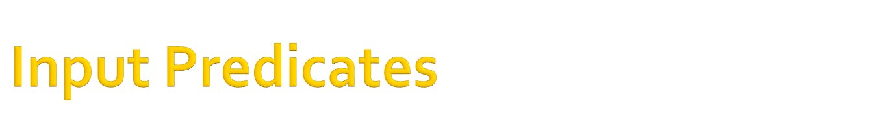
built-in input predicates
  readln predicate → for string/symbol
  readchar predicate → for char
  readint predicate → for integer
  readreal predicate → for real number
  inkey predicate
  keypressed predicate

Slide 8

used to read any string or symbol into a variable.
symptom(Patient , fever):-
write(“does “, Patient, “have a fever?(yes/no)”),
readln(Reply),
Reply=“yes”.
this rule will succeed if user input “yes”. and will fail if user inputs any other things.

Slide 9

used to read single character into a variable.
symptom(Patient,fever):-
write(“does “, Patient, ”have a fever?(y/n)”),
readchar(Reply),nl,
write(Reply).
Reply=‘y’.
this rule will succeed if user input “y”. and will fail if user inputs any other things.

Slide 10
Alternative technique
symptom( Patient, fever):-
  write(“does “, Patient have a fever?(y/n)”),
  response(Reply),
  Reply=‘y’.
reponse(Reply):-
readln(Reply),nl,
write(Reply).

Slide 11

check_age(Patient):-
  write(“What is ”, Patient,” ’s age?” ),
  readint(Age),
  Age>=12,
  write(Patient, “ can not be evaluated with”),nl,
  write(“this system. This system is designed for “),nl,
  write(“childhood disease only”).

Slide 12

Used to read floating point number into a variable
ask_price(Item, Price):-
  write(“What is the price of ”, Item, ”?” ),
  readreal(Price).

Slide 13
End of slide

